Slide 1
ERAU ASCEND! STRUCTURES and SYSTEMS INTEGRATION
Nicholas Hammons

Slide 2
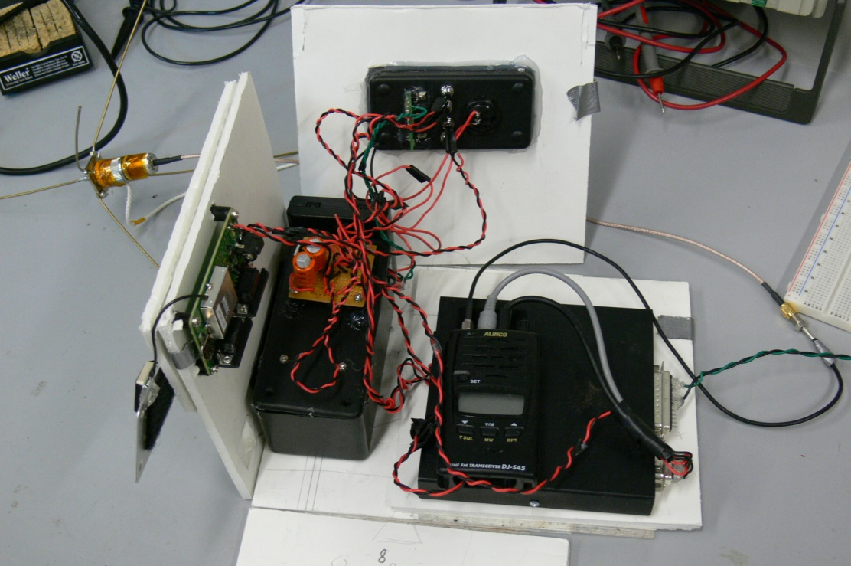
PREVIOUS STRUCTURE
Fold-out poster board mounting
Carbon fiber-epoxy lid
External GPS
Velcro mounting
Inseparable subsystems
Wiring mess

Slide 3
GOALS
Improve component accessibility
Separate subsystems
Reduce wiring mess
Internalize GPS antenna
Integrate PICAXE microcontroller
Add solar cell module
Lighten payload (< 4 lbs)

Slide 4
SOLUTIONS
Accessibility: Slide-out flanges
Sys. Separation: Separate power systems
Separate levels
Wiring: Ribbon cable/connectors
GPS: Glass-epoxy lid
PICAXE: Data board
Solar Cells: Lid-mounted module
Weight: Composites

Slide 5
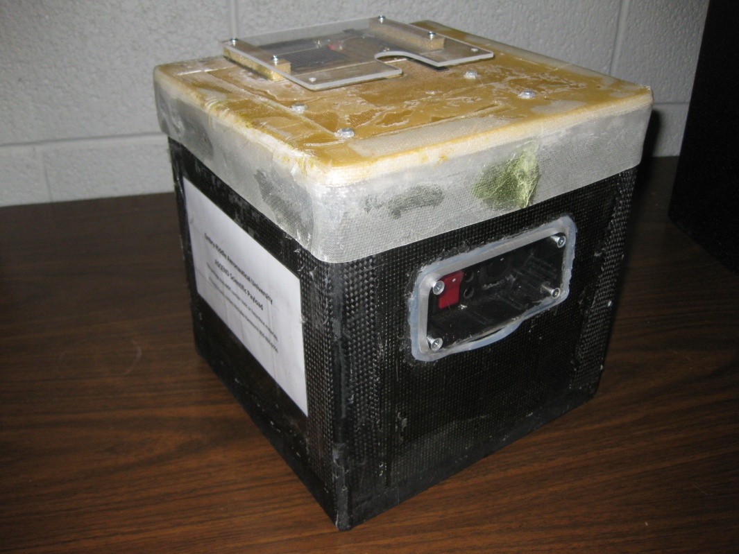
CURRENT PAYLOAD STUCTURE
Shell
Lid
Shelving System
APRS Layer
Data Collection Layer

Slide 6
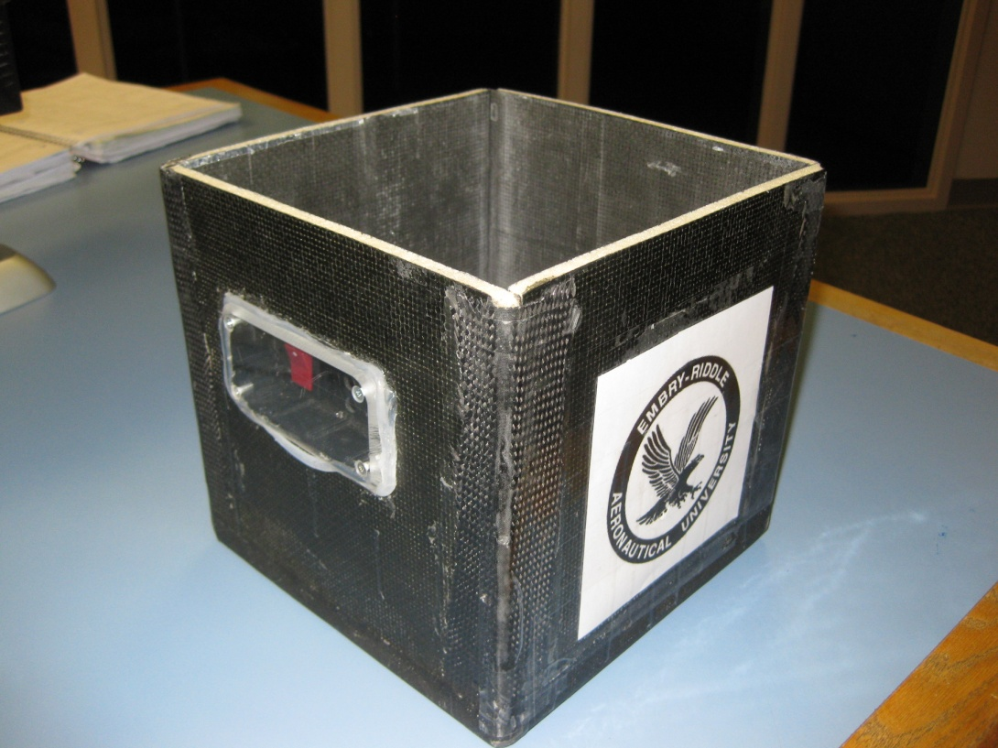
PAYLOAD SHELL
Inherited/reusable shell
5 launches
8” x 8” x 8” cube
Bi-directional carbon fiber
¼” foam core
External access to on/off switches
~ 421 in³ useable volume

Slide 7
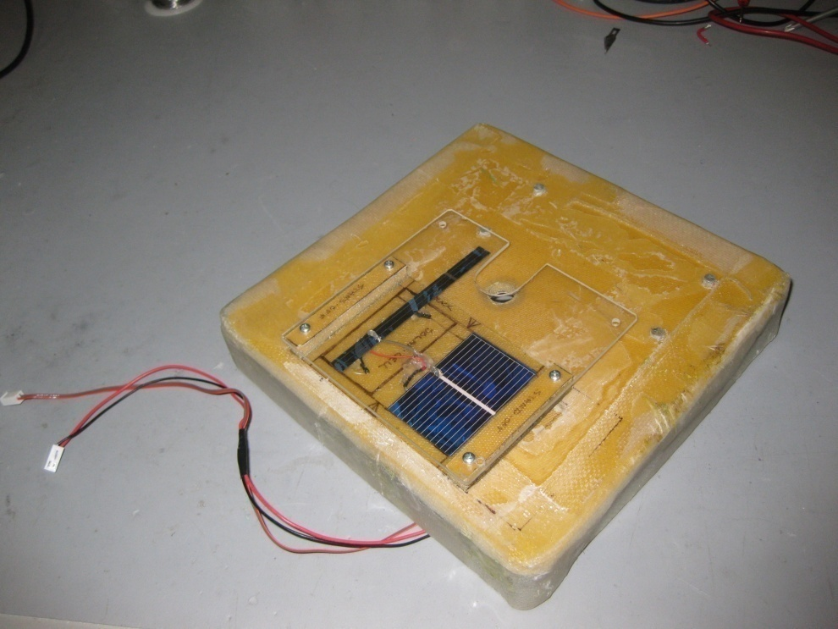
PAYLOAD LID
Glass-epoxy
GPS transmission
¼” foam core
GPS antenna/ground plane mounted internally
Solar cells mounting
Silicon gel to reduce heat flux

Slide 8
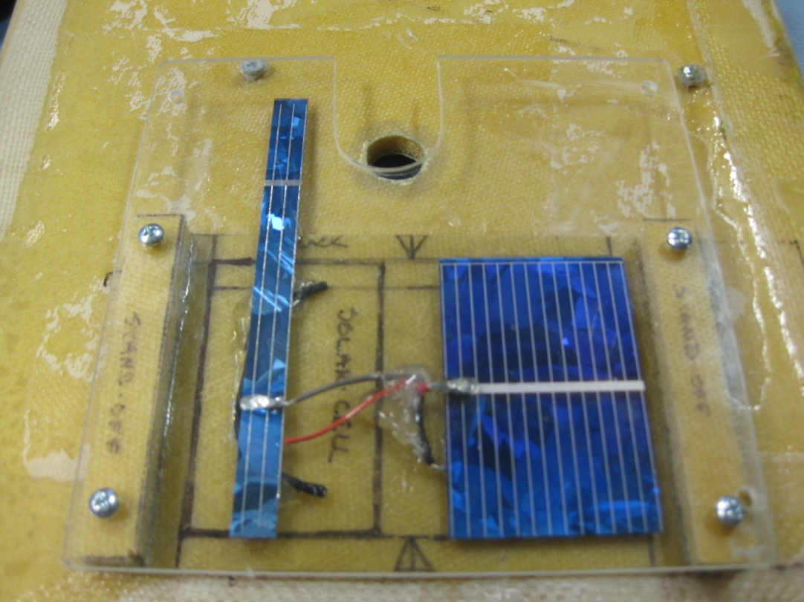
SOLAR CELL MODULE
Glass-epoxy
¼” foam core
Plexiglas cover

Slide 9
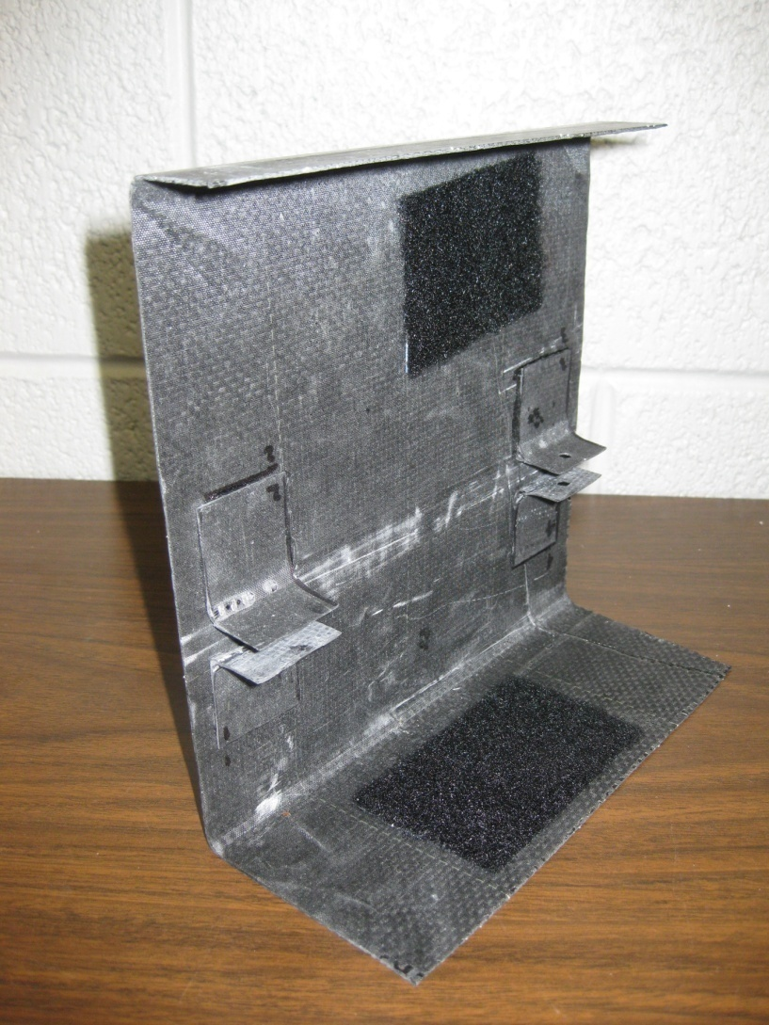
SHELVING SYSTEM
Mimic EYASSAT NanoSat Modules
Separate power requirements
Carbon fiber-epoxy laminate
Slide-out flanges: 3-ply
Brackets: 2-ply
Reduces structure volume and weight
~ 7.5% more internal volume
(vs. Nov. 22, 2008 launch)

Slide 10
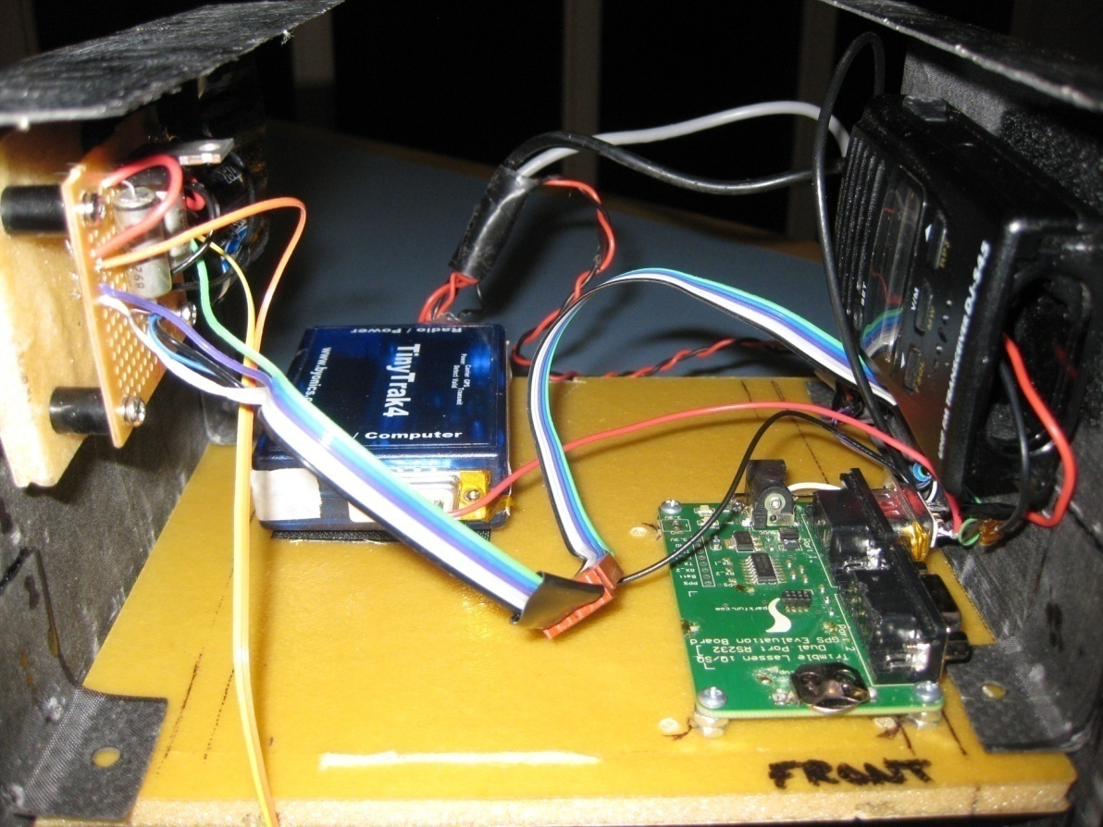
APRS LAYER
TinyTrak 4
Radio
GPS Evaluation Board
Voltage Regulator
AA Battery Pack

Slide 11
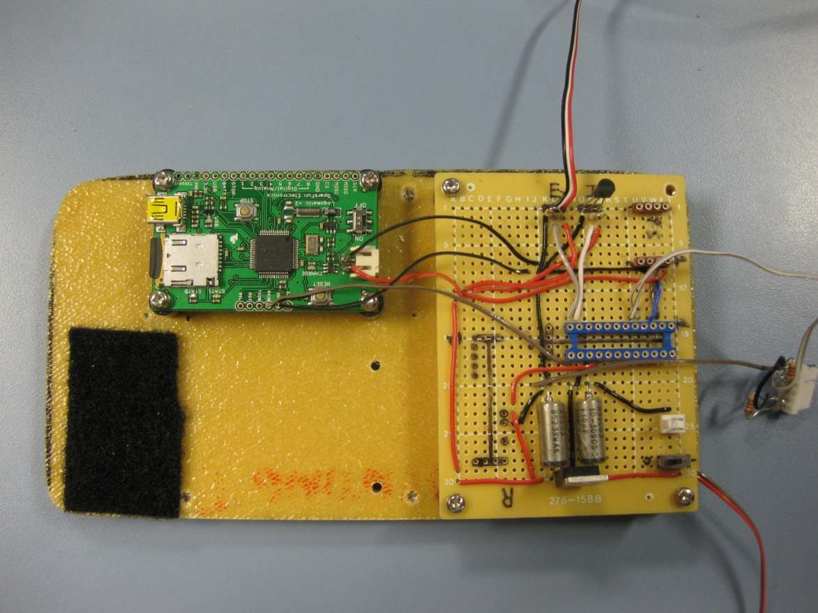
DATA COLLECTION LAYER
¼” foam core
Data board:
PICAXE
Logomatic
Voltage Regulator
Internal/External Temperature Sensors
Pressure Sensor
AA Battery Pack

Slide 12
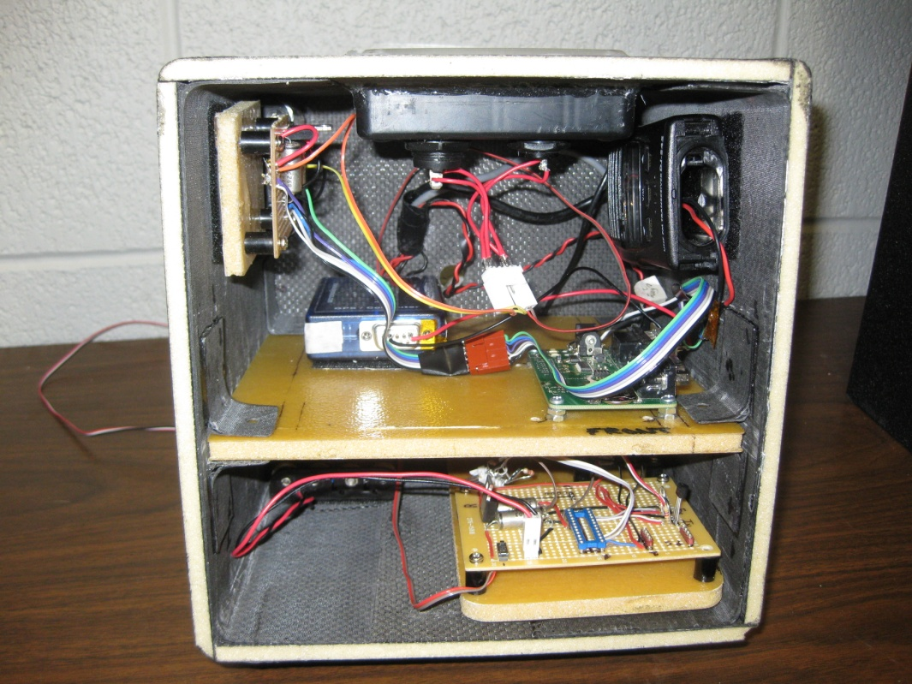
SYSTEM INTEGRATION
Velcro mounting
1 cross-board connection
On/off switch
2 lid to payload connections
Solar cells
GPS antenna
External on/off switches
Payload weight at launch:
3 lbs 11 oz

Slide 13
FUTURE IMPROVEMENTS
Integrate data collection system into PC boards
Convertible payload
Reduce APRS volume to maximize space for collecting data
Fabricate sun sensor module
Improve thermal regulation

Slide 14
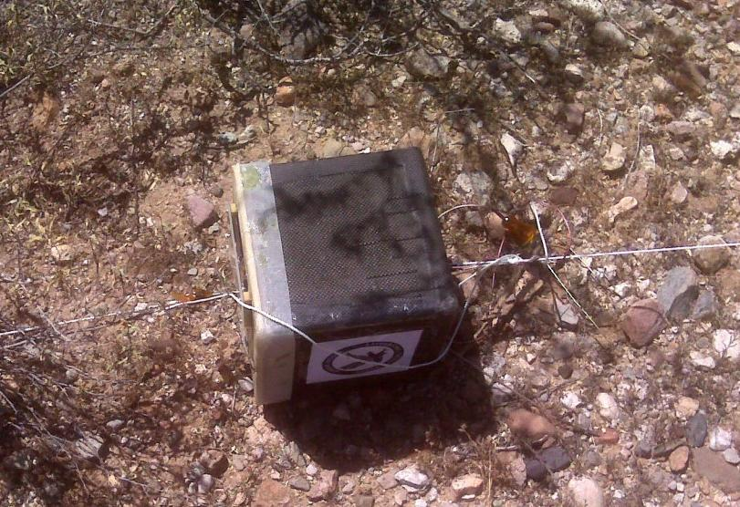
QUESTIONS

Slide 15
ATTITUDE DETERMINATION
Andrew Grant

